Slide 1
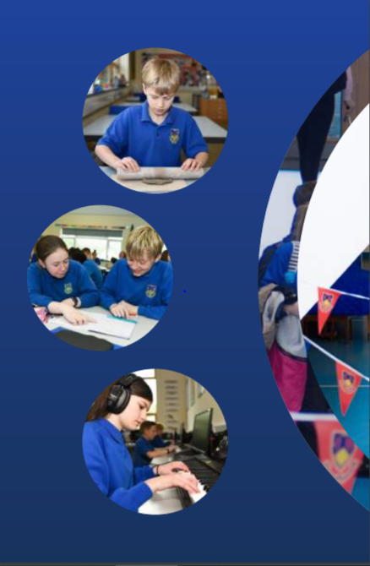
Working Together,
Achieving More
Cydweithio a Chyflawni
Year 12 and 13 Information Evening
4th November 2021
A-Level Art and Design.

Slide 2
Course content and delivery
In Year 12 pupils will be focused on developing their skills in a variety of media, to produce a portfolio of work that reflects their ability and interests.
Year 13 will develop their personal investigation which is a practical unit that explores an area of art, craft and design chosen by them.
There will not be an exam in 2022 this academic year due to covid restrictions.

Slide 3
Assessment
How is the course assessed?
The course is assessed by the class teacher as it is 100% coursework in Year 12.
In Year 13 the coursework is assessed by the class teacher and moderated externally by the WJEC. (There will be no exam in 2022 due to Covid restrictions.)
When will the assessments take place?
Both Year 12 & 13 pupils will be given feedback on their week at regular intervals through the year; with the coursework portfolio being handed in for marking in April to meet the WJEC deadline in May.
What preparation needs to be done beforehand?
Pupils need to work continually throughout the year to ensure they are well prepared for the deadline.
Will pupils have resit opportunities to improve their results?
Pupils would need to re-submit their work the following year, with additional work if they would like to increase their marks.

Slide 4
Skills Development
What skills will pupils develop through studying the course and how will they do this?
Students will explore a variety of different media in the different areas of Art, Craft and Design. These include textiles, 3D work, digital Art, as well as painting and drawing to name but a few. Students will also develop their analytical skills while exploring the work of other artists. Both will then be applied to their own ideas, utilising their creativity.
What can they do to practise these skills?
It is essential that students work on their portfolio continually throughout the year within the lessons as well as outside of contact time.
How can these skills be applied to different subjects/areas of life?
Creative thinking can be applied in all subjects where problem solving is needed.

Slide 5
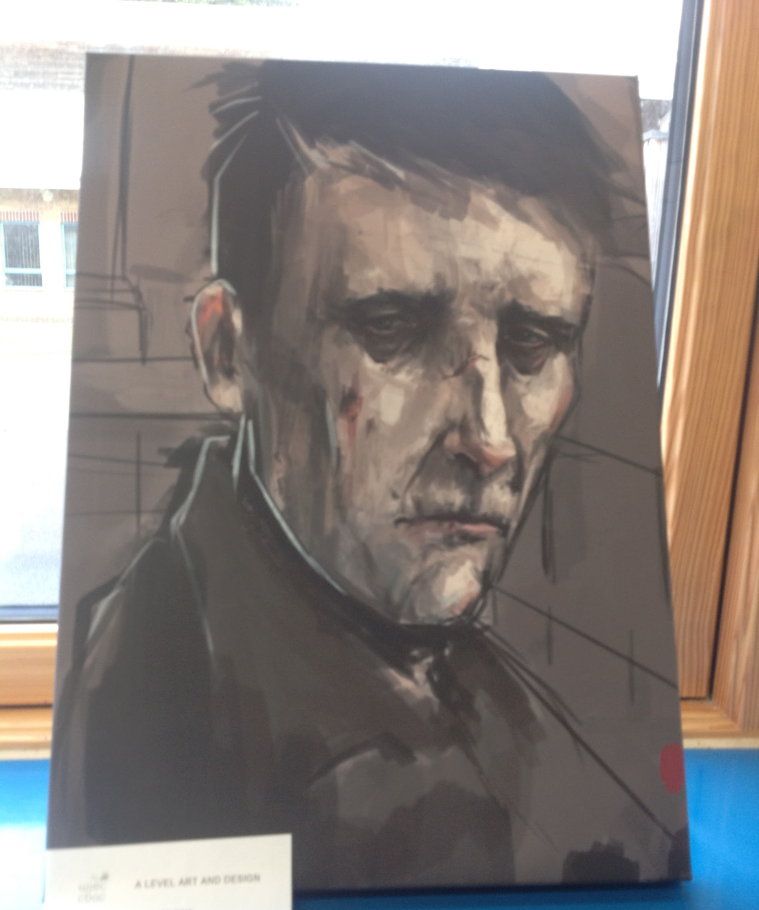
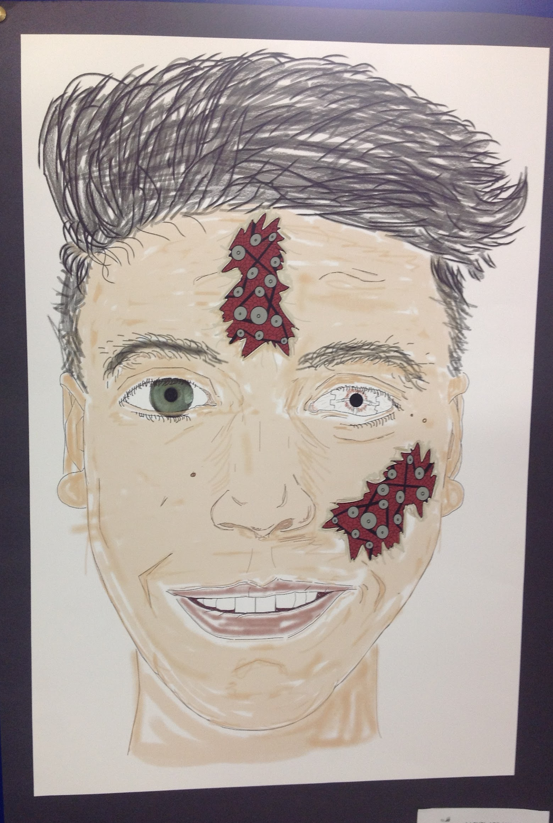
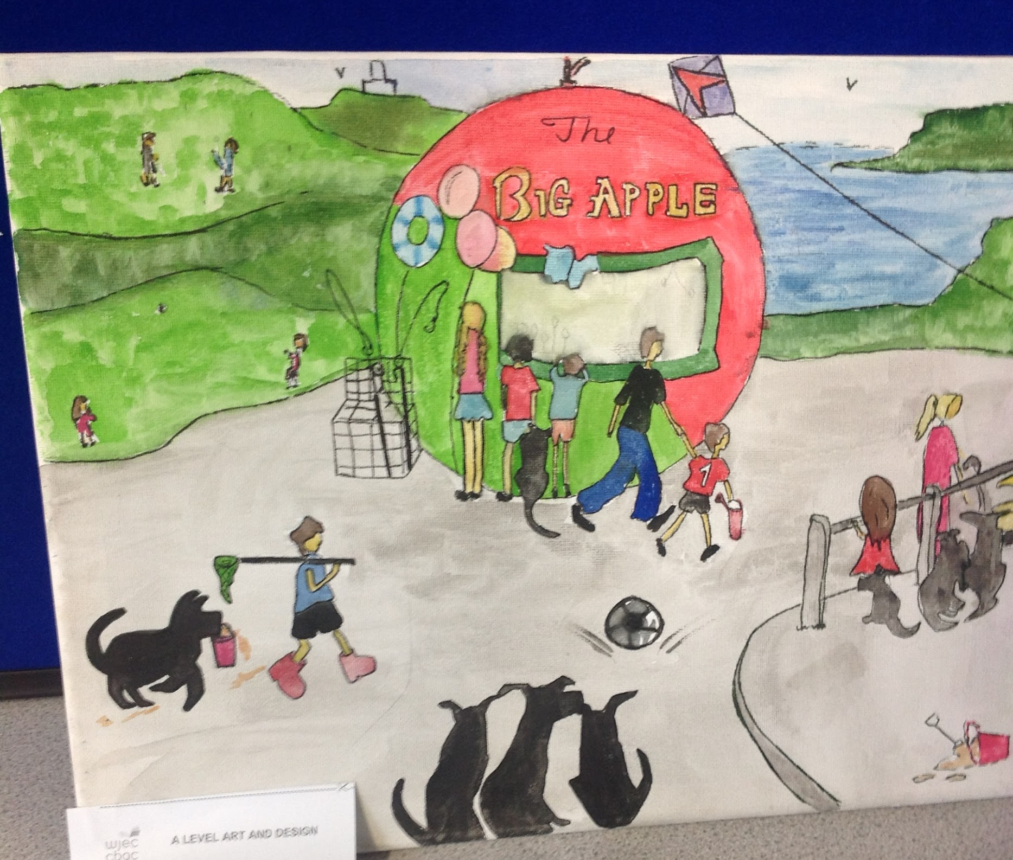
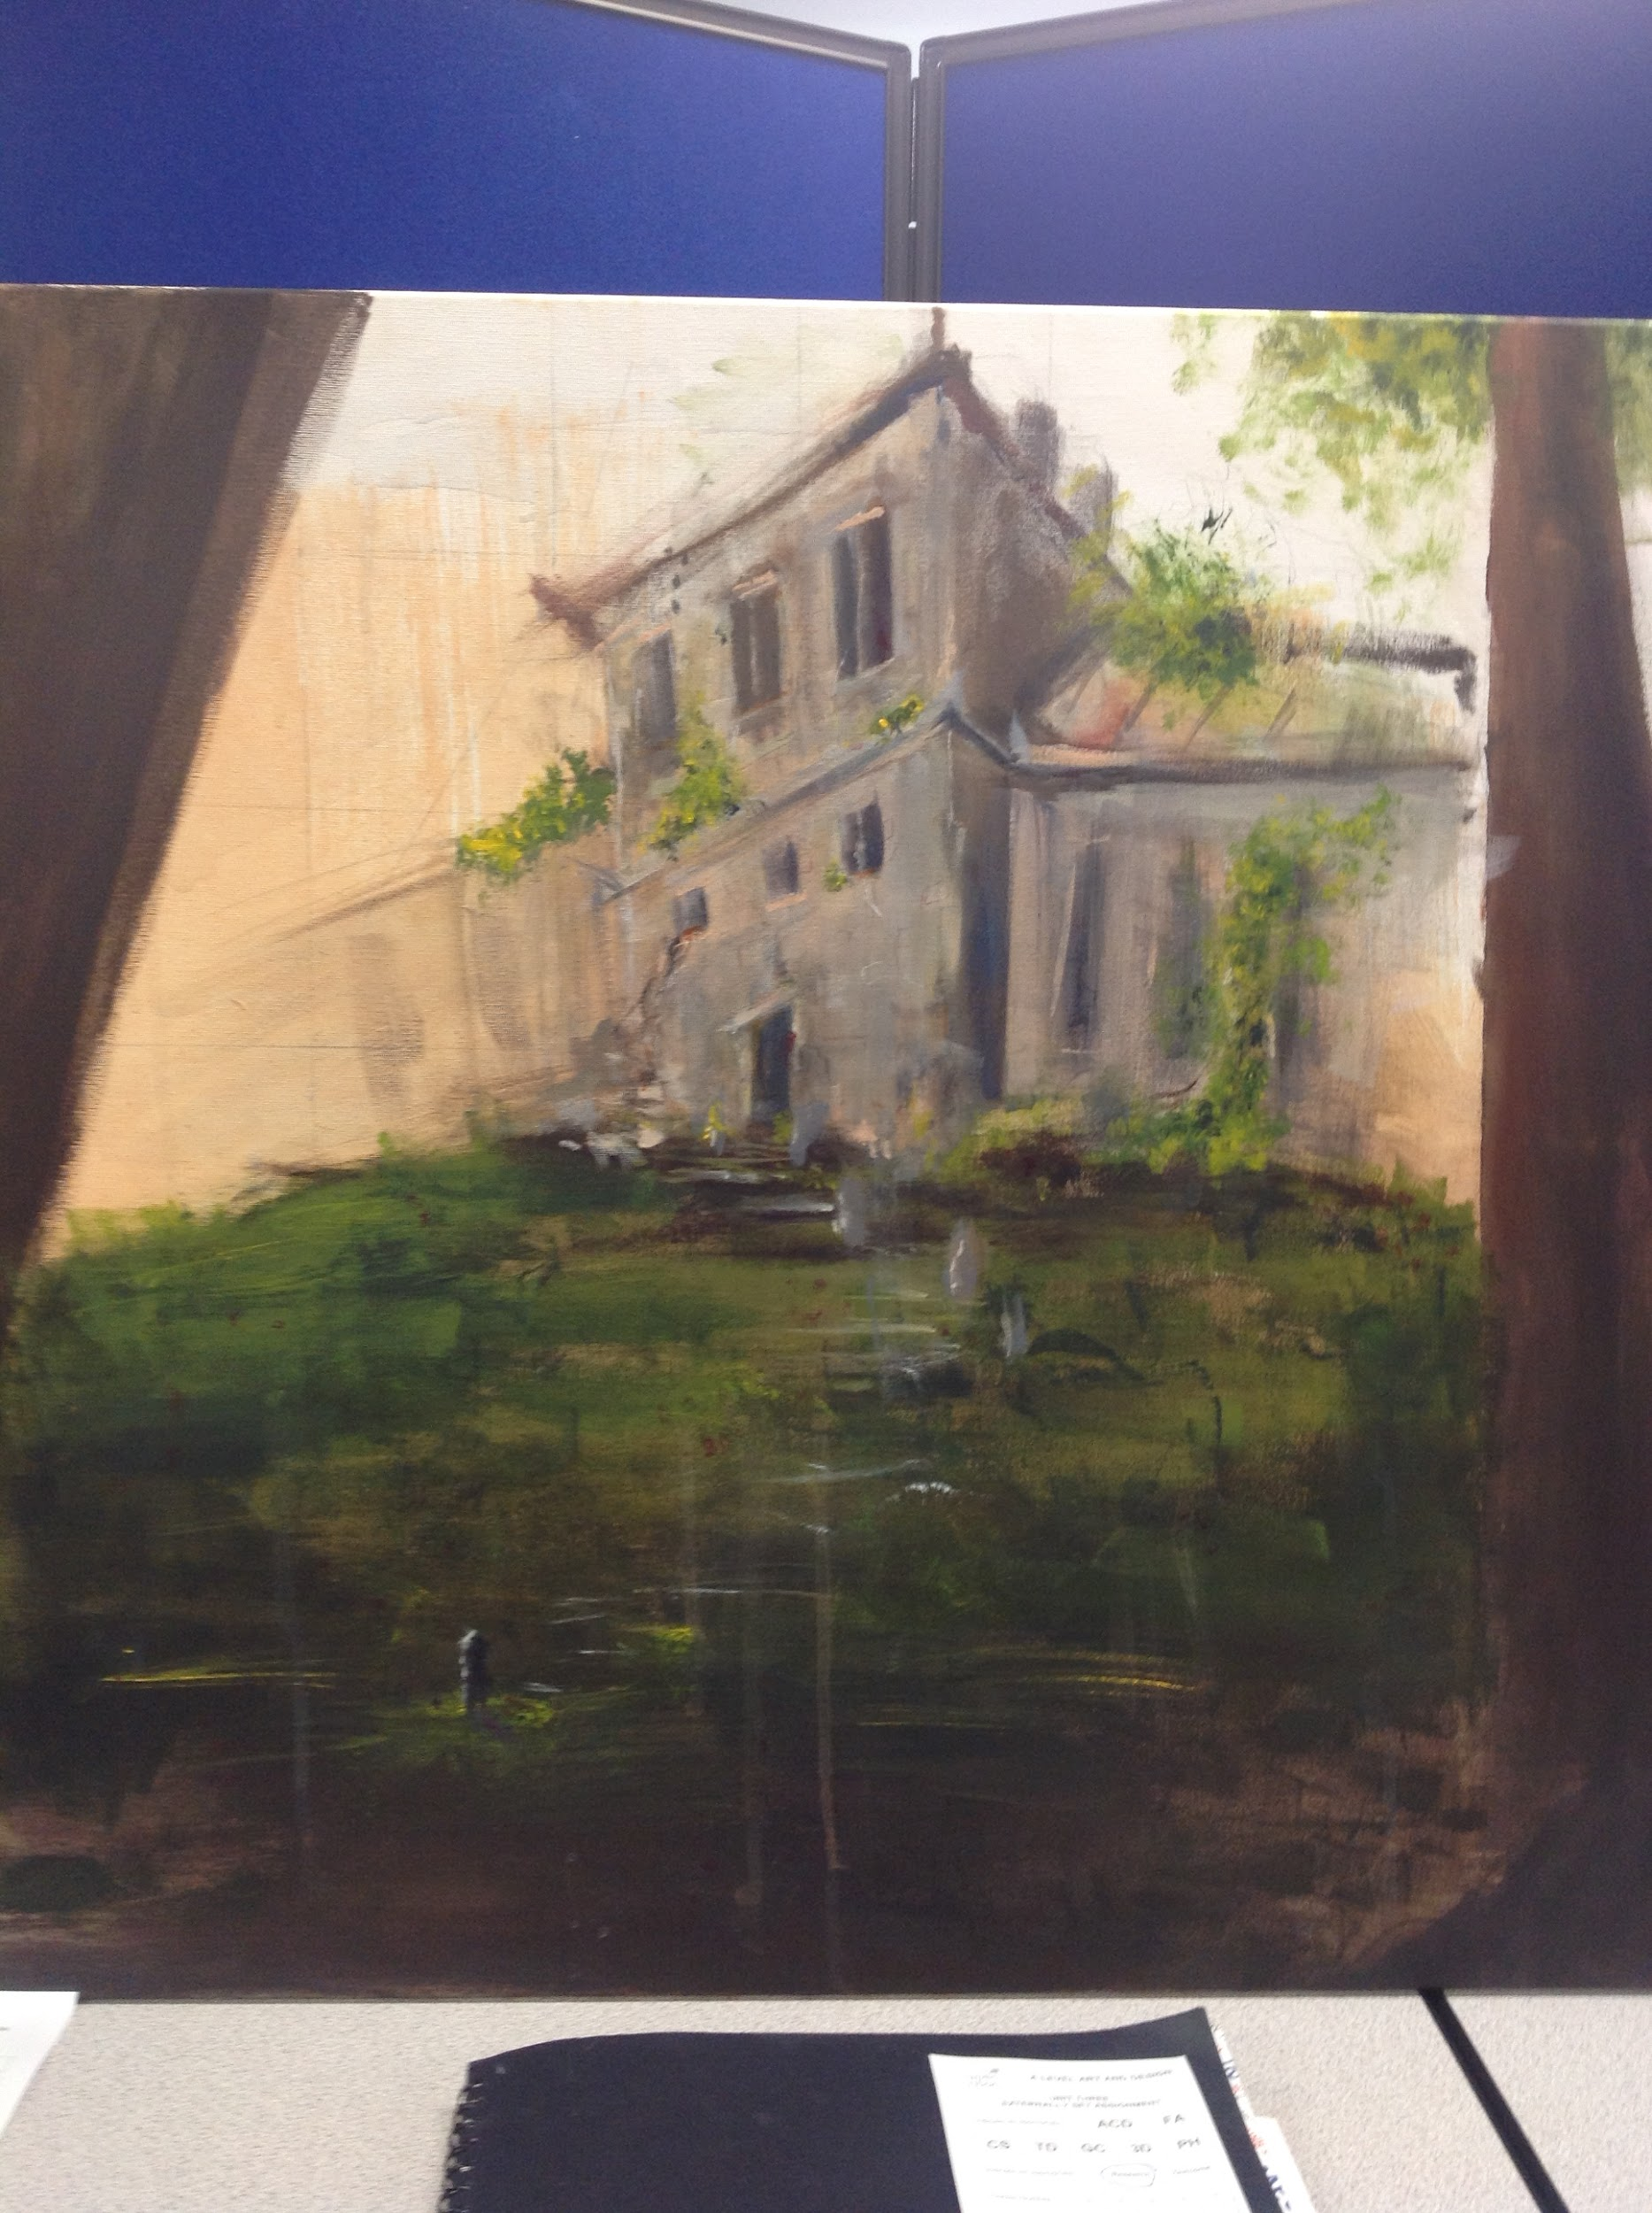
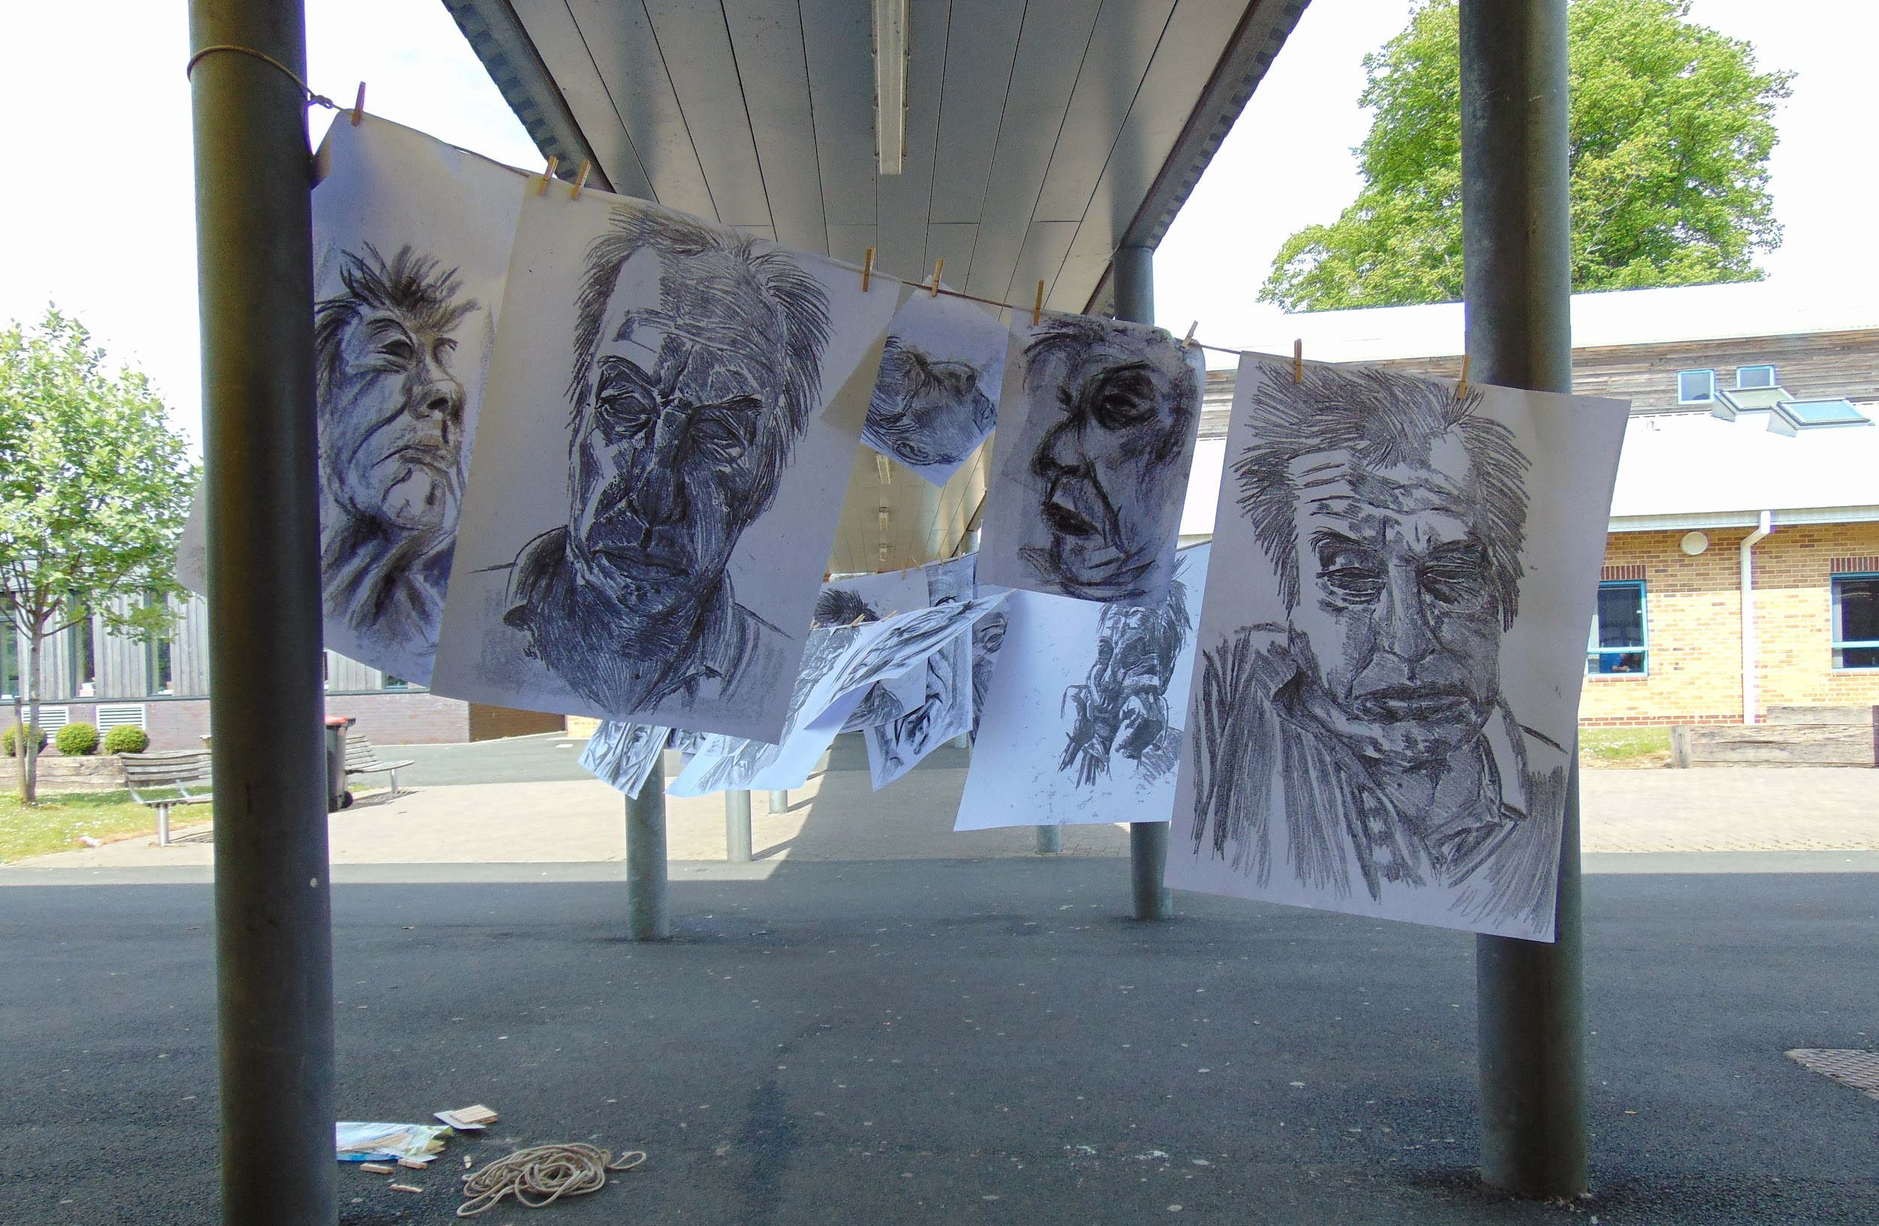
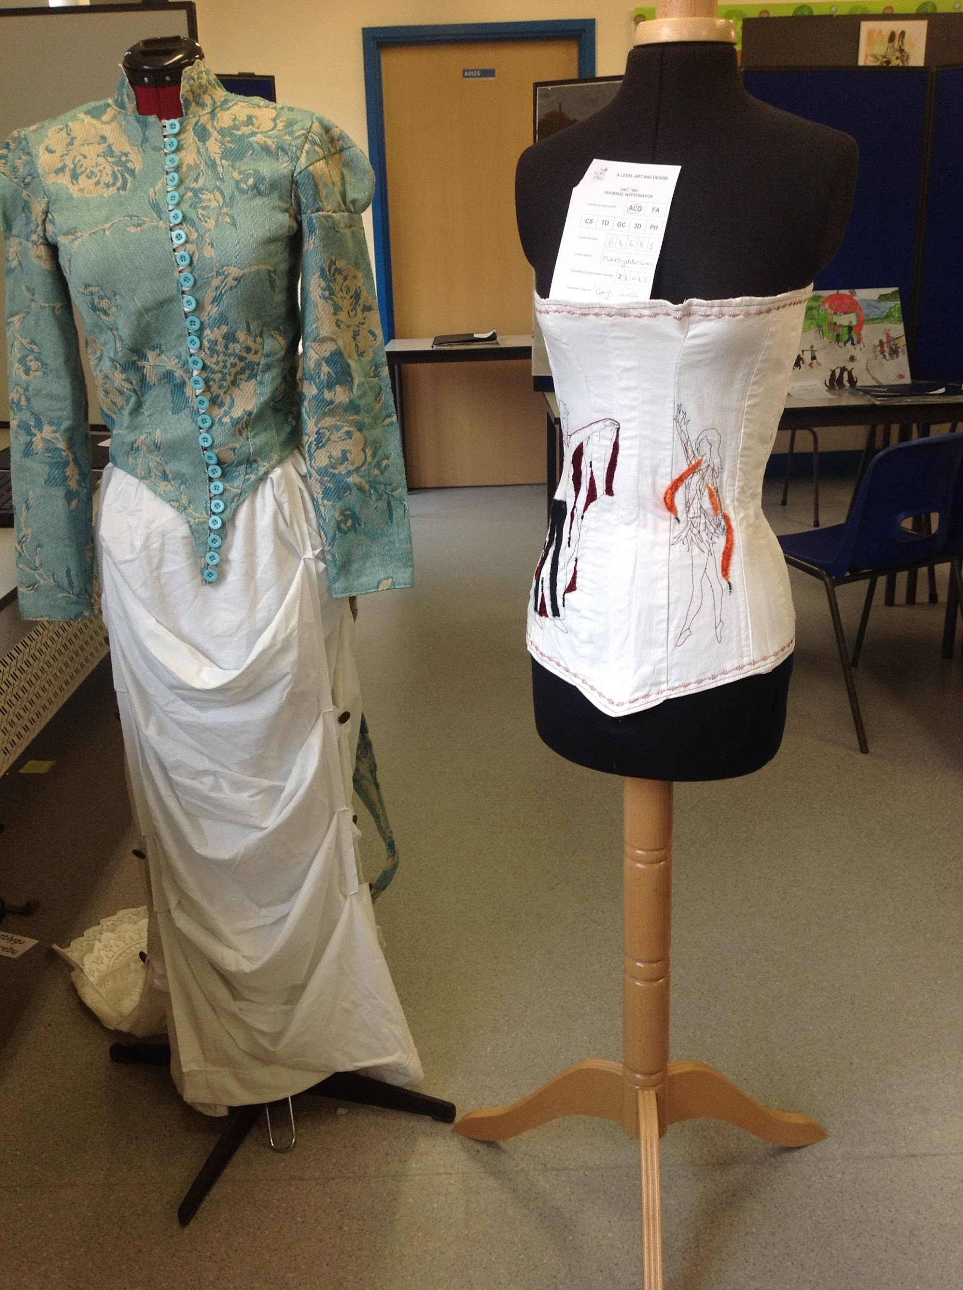
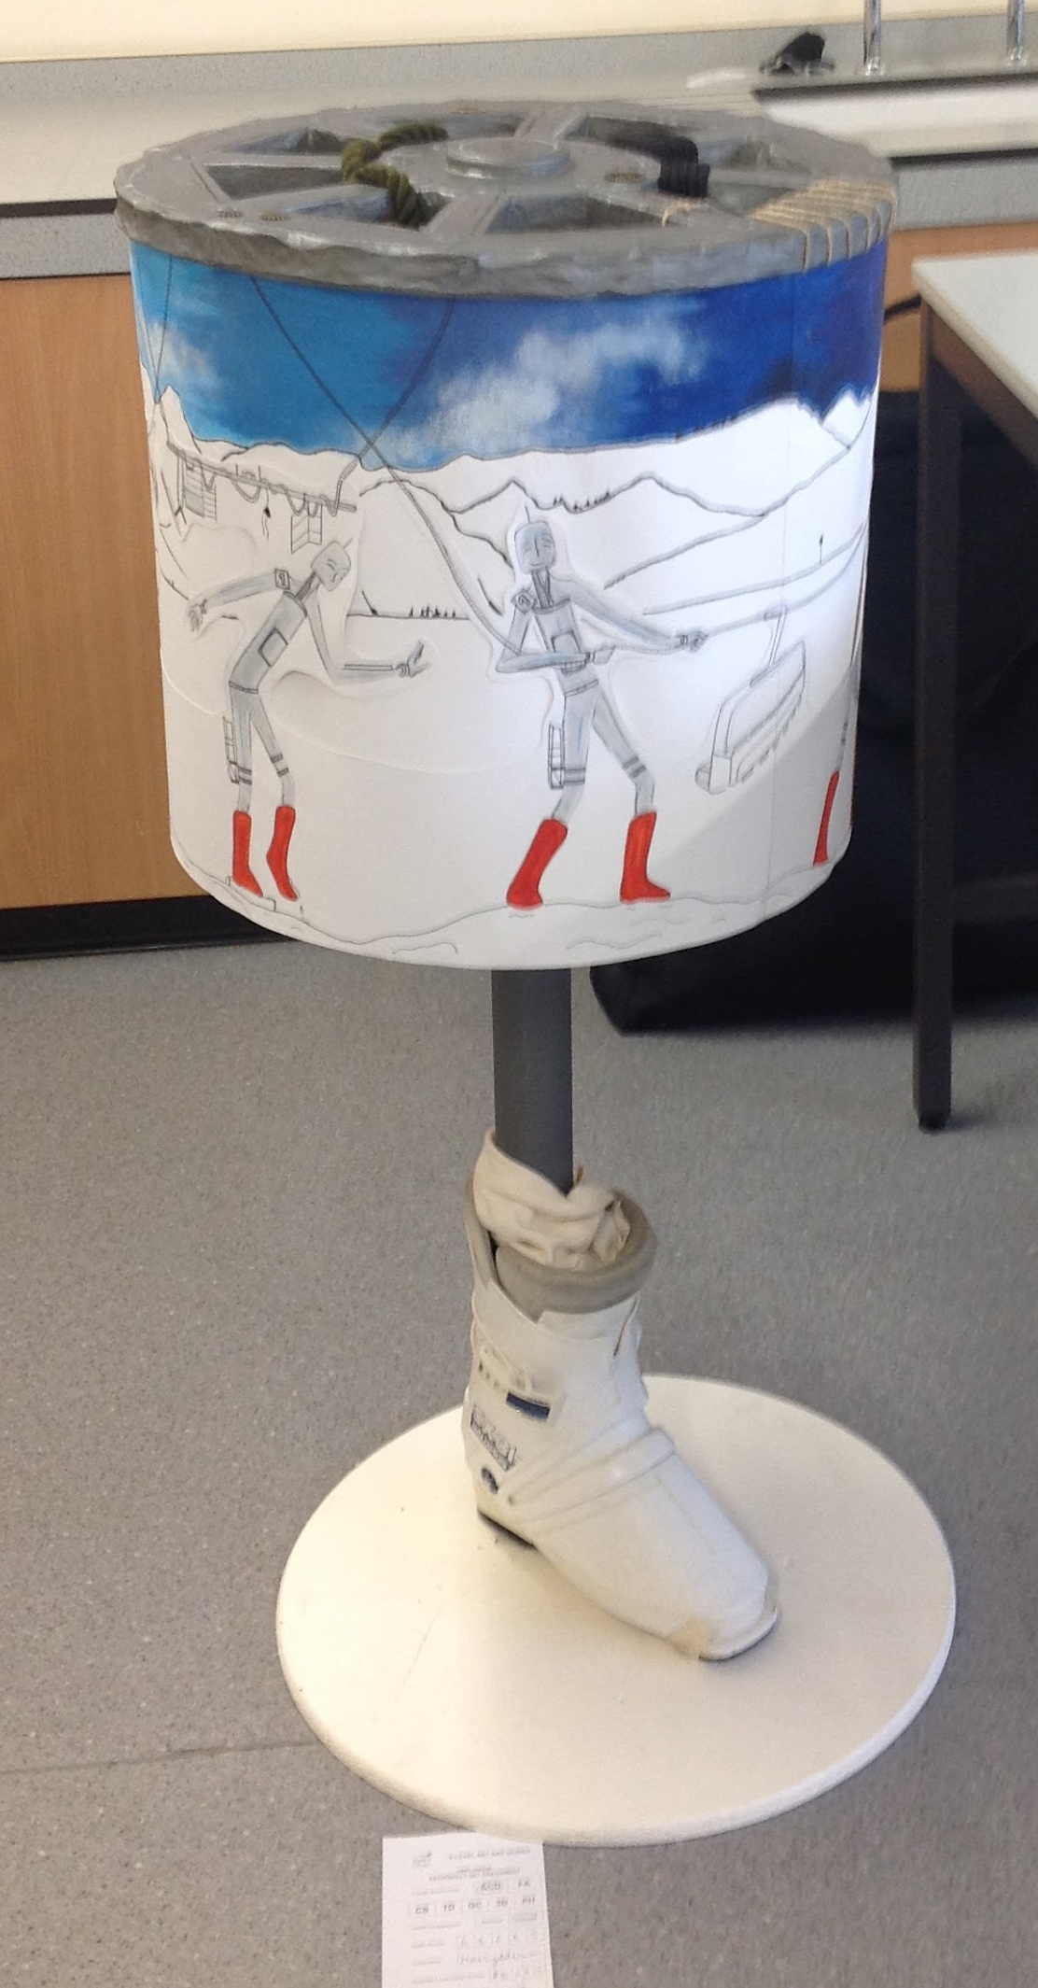

Slide 6
Our Expectations
All work should be presented in a sketchbook or presentation file and should be A3 size.
Homework is continual. Tasks started in class should be continued at home and techniques explored further in the students own time.
Regular deadlines will be set for ongoing assessment. It is essential that these are met to allow students to produce the quantity of work needed to cover all of the assessment objectives well.
Students will need to bring their sketchbooks to each lesson as well as basic art supplies. As they find an area of specific interest to them, they may want to invest in more equipment, but that is up to the student and not a requirement.
The more creative experiences students have to draw on in their work, the more personal and interesting their work will be.

Slide 7
Resources and Support
What resources will you make available to support learning?
Students will be given demonstrations in lessons in a variety of different techniques to expand their knowledge and skills within Art, Craft and Design. Students will also have support material to help them analyse the work of other artists and develop a response to it.
What support both within and outside lessons will be provided to support pupils?
The class teacher will give students one-to-one support and feedback throughout each lesson. Students will have access to the sixth form Art room throughout the week outside of lesson time.
How can parents/carers support their children in your subject?
It is essential that student work on their sketchbooks outside of lessons and meet deadlines, to avoid poor coverage of the assessment objectives and putting themselves under pressure before the deadline.

