Slide 1


Working Together,
Achieving More
Cydweithio a Chyflawni
Year 10 and 11 Information Evening
21st October 2021
Cymraeg

Slide 2


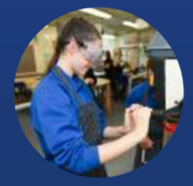
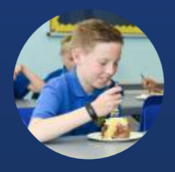
Course content and delivery
The qualification is made up of four units: Unit 1 and 2 are non-examination speaking and listening assessment, Unit 3 and Unit 4 are reading and writing examinations.
The context for learning the language is organised under three broad themes:
EMPLOYMENT
WALES AND THE WORLD
YOUTH
When studying Cymraeg pupils will be required to cover the following area:
Listening – understand and respond to different types of spoken language
Speaking – communicate and interact effectively in speech
Reading – understand and respond to different types of written language
Writing – communicate in writing

Slide 3
Assessment
UNED | % | SGILIAU | ASESU
UNED 1 | 25% | Listening 15% Speaking 10% (50 marc) | Non-examination assessment (Summer)
UNED 2 | 25% | Speaking 20% Listening 5% (50 marc) | Non-examination assessment (Summer)
UNED 3 | 25% | Reading 15% Writing 10% (100 marc) | Exam (Summer)
UNED 4 | 25% | Writing 15% Reading 10% (100 marc) | Exam (Summer)
Uned 1 will take place in April 2022 for Year 10 and 11.
Year 11 will not sit Unit 2 but will Sit Unit 3 & 4 in May 2022.
Year 10 will sit Unit 2 in April 2023, 3 & 4 in May 2023

Slide 4
Skills Development
GCSE Welsh second language is a compulsory core subject across the whole of Wales and will enable pupils to:
• understand and use the language for a variety of purposes and audiences
• develop language learning skills and strategies in order to enable candidates to communicate and interact confidently and spontaneously in relevant situations and specified context
• develop language learning skills and strategies to enable candidates to develop their grasp Welsh further
develop listening, speaking, reading and writing skills in an integrated manner, emphasising listening and speaking skills
• use Welsh in further studies, in the workplace and in their communities
• develop curiosity about the Welsh language.

Slide 5
Our Expectations
We expect all pupils to have a positive attitude towards learning the language of Wales.
Participate in lessons fully.
All books be neat and up to date.
Homework to be completed by the deadline which is set on Google classroom.
To be equipped for every lesson.

Slide 6
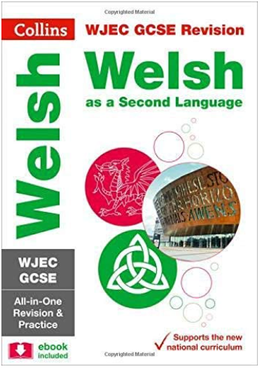
Resources and Support
Pupils can email their teachers in the department for support and help, or ask within Google classroom on something specific.
They can also make use of:
WJEC GCSE Welsh as a Second Language All-in-One Complete Revision and Practice
Duolingo
Kahoot
GCSE Pod
Cysill ar lein
Geiriadur y Academi
BBC Bitesize

