Slide 1
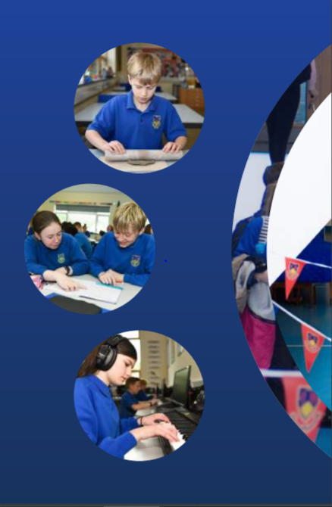
Working Together,
Achieving More
Cydweithio a Chyflawni
Year 10 and 11 Information Evening
21st October 2021
GCSE Food & Nutrition

Slide 2
Course content and delivery
Food and nutrition is a fantastic course that will equip the learners with the knowledge, understanding and skills required to cook and understand food science, nutrition and healthy eating. The course encourages learners to cook and make informed decisions about food and nutrition and also about how to feed themselves nutritiously.
The course is delivered in a fun and approachable way with a mix of practical tasks which take place at least once a week and theory/coursework tasks. The learners will learn about the following:-
Food commodities
Principles of nutrition
Diet and good health
The science of food
Where food comes from
Cooking and food preparation

Slide 3
Assessment
The course is split as 60% and 40%.
Unit 1 :A written examination: 1 hour 30 minutes and counts for 40% of the qualification.
Unit 2: Food and Nutrition in Action is a non-examination assessment which is internally assessed and externally moderated. Assessment 2 takes 15 hours of learning and counts for 60% of the qualification.
The pupils will be assessed throughout the year with past paper questions, a mock exam, a coursework grade and a written exam in May/June 2022.
Practical tasks will be carried out on a weekly basis to develop and improve pupils skills. Time will be given for research for the assessment 2 coursework.
There is no opportunity to re-sit this subject.

Slide 4
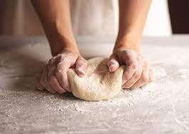
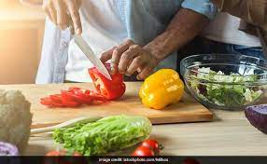
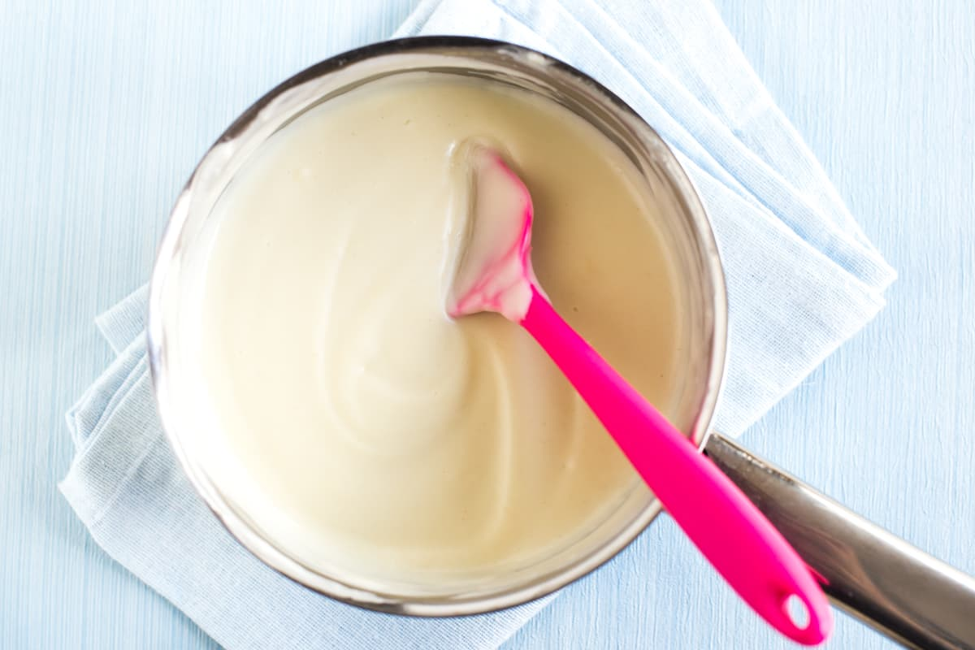
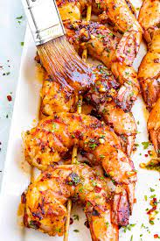
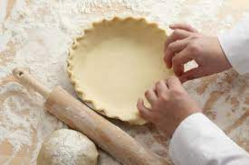
Skills Development
Pupils will develop a range of skills through the course such as:-
Knife skills
Preparing fruit and vegetables
Weighing and measuring
Tenderising and marinading
Making sauces
Pastry making
Making a dough
Shaping and finishing a dough

Slide 5
Skills Development
Learners can practice these dishes at home as all recipes are placed onto Google Classroom on a weekly basis with the equipment, ingredients and methods listed.
The skills learnt throughout this course will build a foundation to study Food and Nutrition at Level 3 or for a Catering course at a higher level at college. Pupils will develop their skills in literacy, numeracy, critical thinking and problem solving, planning and organisation and individual creativity and effectiveness.
The career opportunities are endless within this subject such as:-
Chef
Catering manager
Nutritionist
Caterer
Baker
Career within the army
Food teacher
Dietician
Café or restaurant (own business)

Slide 6
Our Expectations
All theory work needs to be completed in preparation for the written exam in June of 2022. Pupils are supplied with exercise books and are given a wide range of different work to complete in lesson time.
Homework is expected to be completed on a regular basis especially when pupils have started their Assessment 2 coursework.
A mock theory exam will be carried out in December and a mock practical task will be carried out every half term to continue to develop pupils independent working skills.
Ingredients are provided from home as they have been since year 7. Pupils are aware that some ingredients are given from school such as herbs, spices, flour etc.
All of the equipment that the pupils require for the practical tasks are provided by the food department.

Slide 7
Resources and Support
All theory and practical resources are available through google Classroom which in turn will support each pupils learning. Books are marked on a regular basis.
Pupils are nominated for chef of the week on a weekly basis.
Dinner time ‘catch up’ club will be available in January as a check in and catchup on any incompleted coursework.
Parents/carers can support their children in this subject by downloading the Schoop app in order to keep track on reminder txt that are sent home for practical tasks.

