Slide 1



Working Together,
Achieving More
Cydweithio a Chyflawni
KS5 Information Evening
Science suite:
Biology
Chemistry
Physics
Medical Science

Slide 2
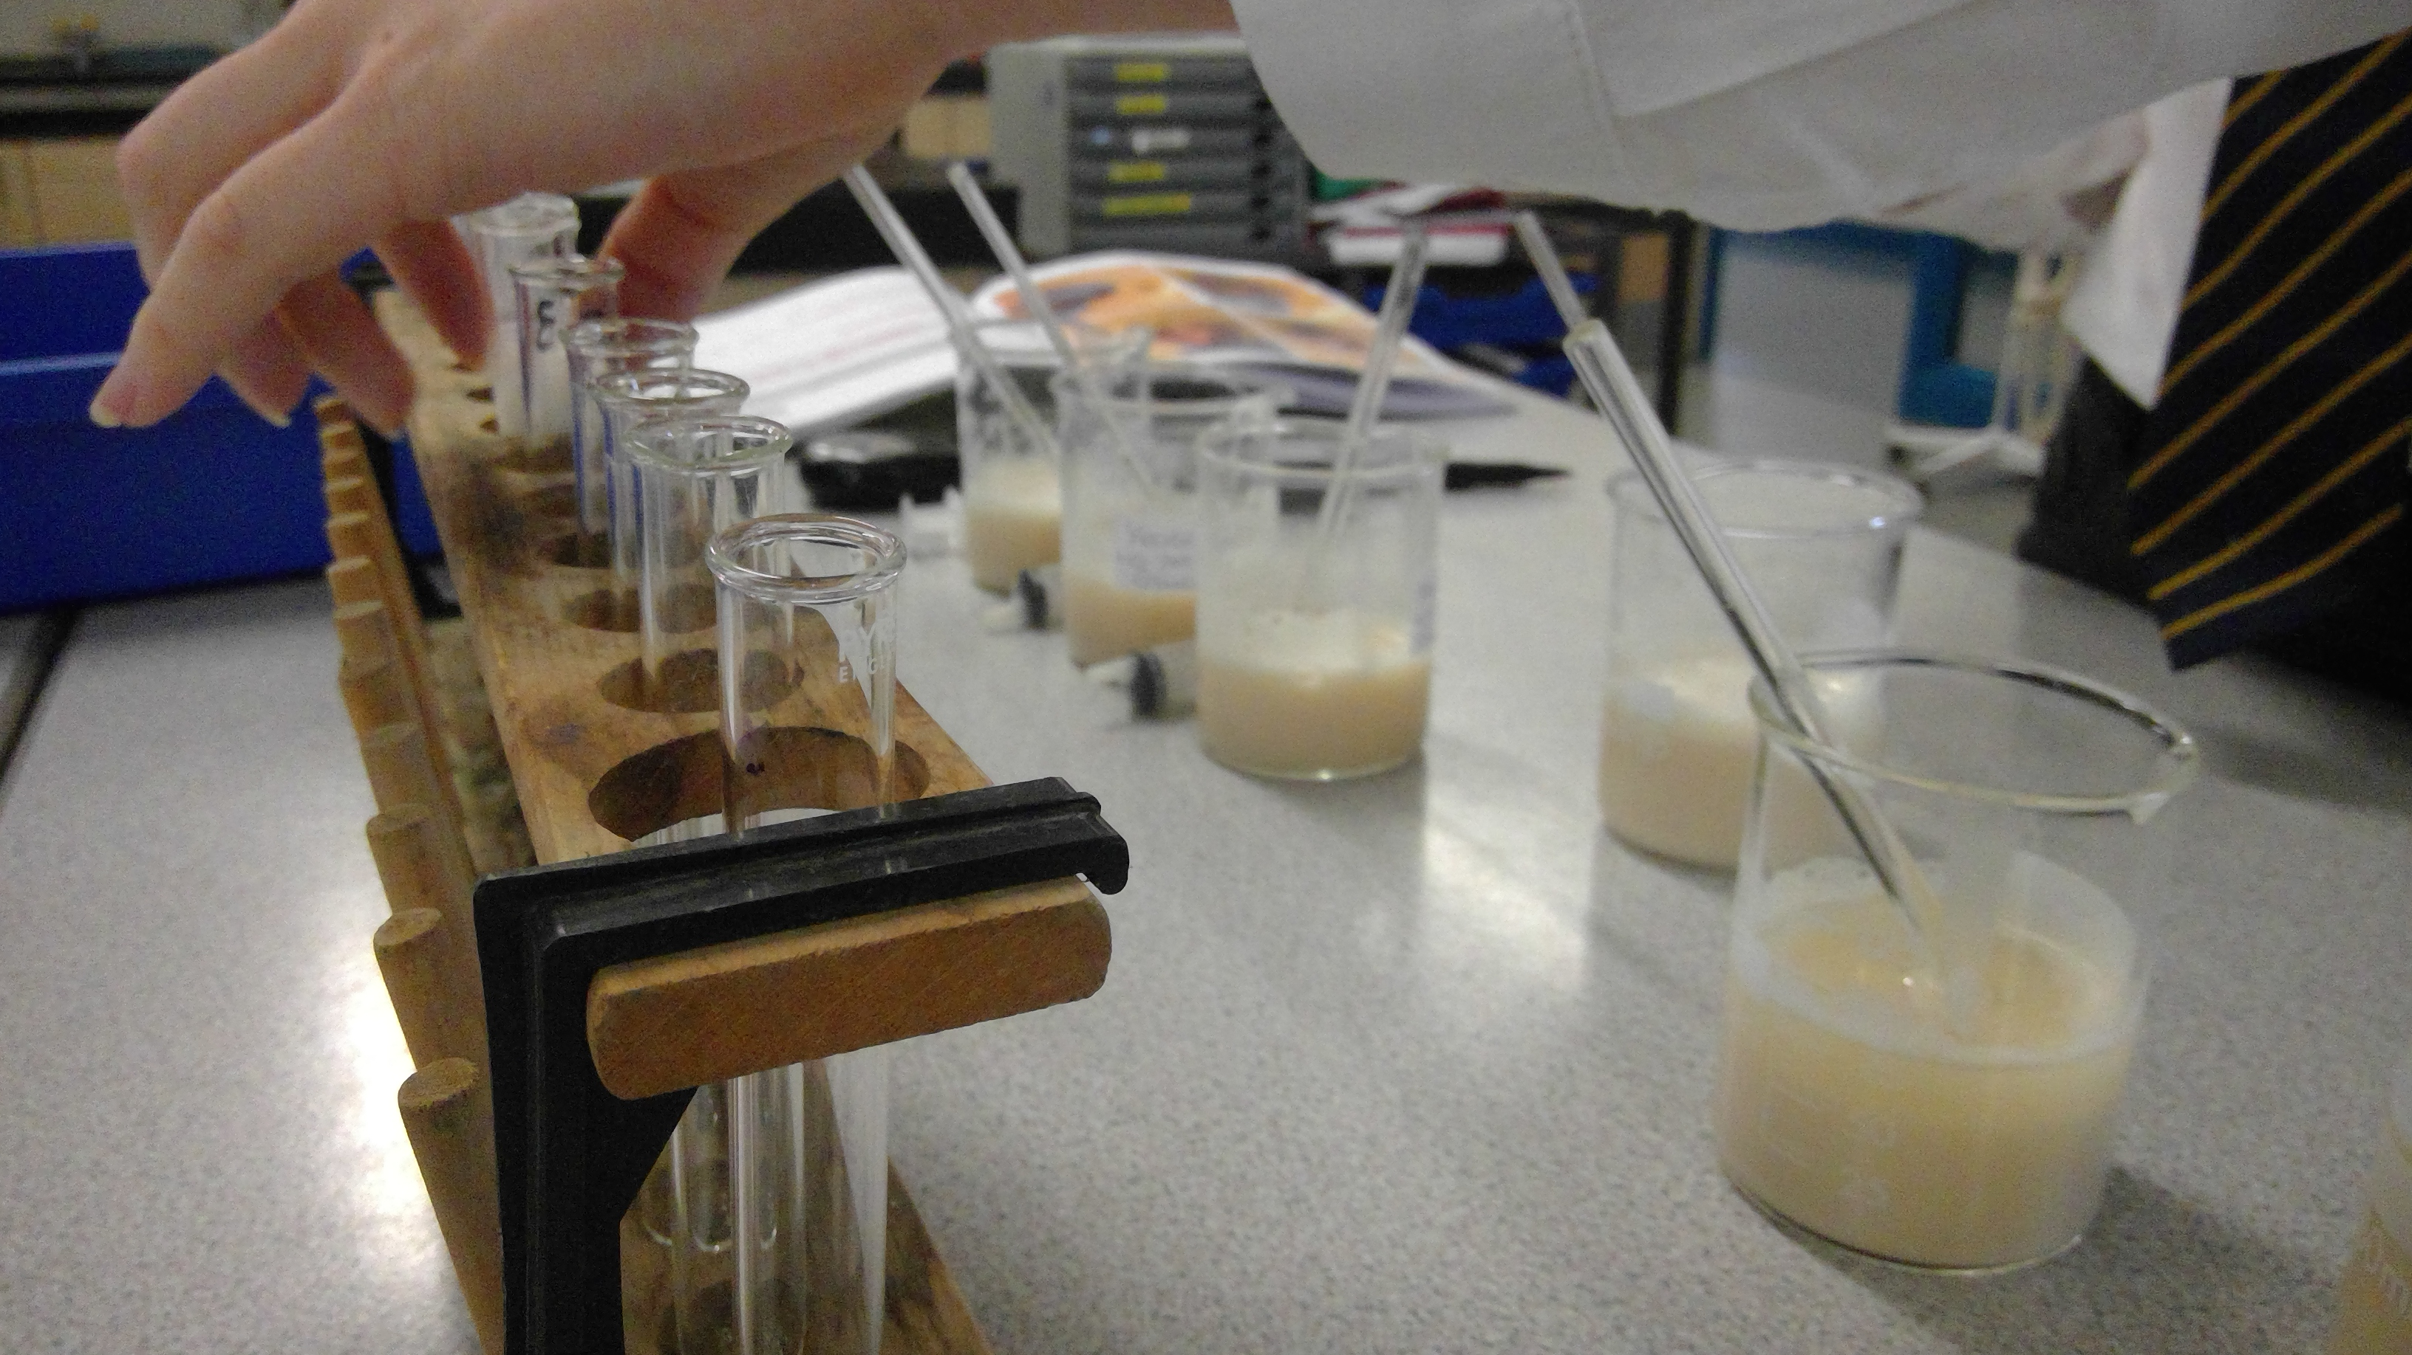
Biology

Slide 3
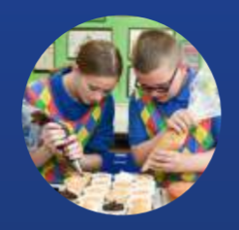
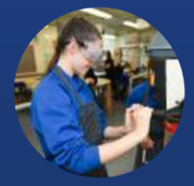
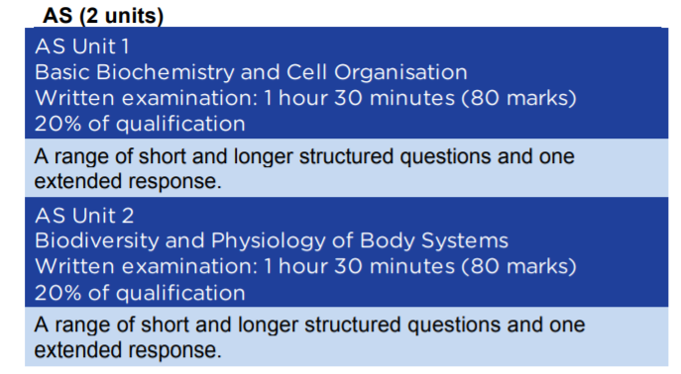
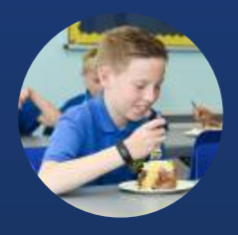
Course content and delivery
Give a brief outline of the course content and the method of delivery over the 1 – 2 years

Slide 4
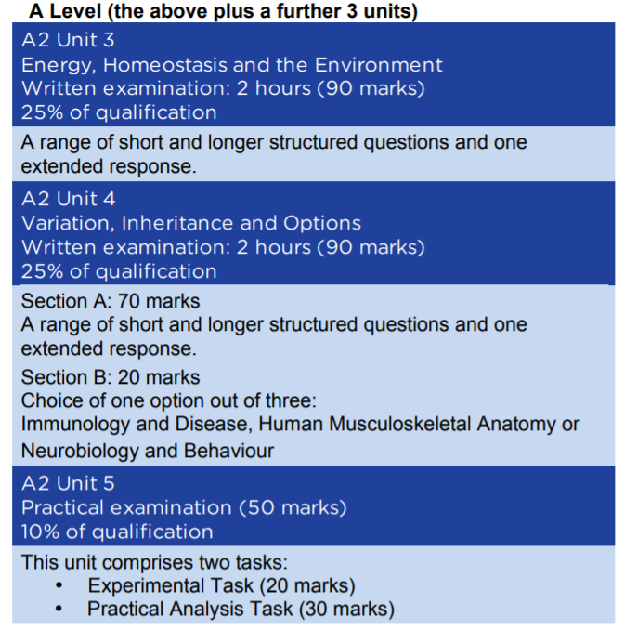

Slide 5
How can these skills be applied to different subjects/areas of life?
The study of biology encourages an appreciation of these issues and their implications as well as providing an insight into the living world.
The inclusion of optional topics allows learners to gain a deeper insight into a wider range of biological topics. It is intended that the use of a variety of approaches will stimulate interest, promote understanding and engender an overall appreciation and sense of wonder at the living world.
This specification promotes an understanding of scientific method as the means to increase scientific knowledge and develop an enquiring and critical approach. Learners will develop an awareness that different perceptions, predictions and interpretations may be applied according to context.
Practical work is an intrinsic part of biology, and is greatly valued by higher education. It is imperative that practical skills are developed throughout this course and that an investigative approach is promoted.

Slide 6
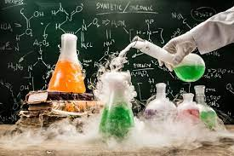
Chemistry

Slide 7
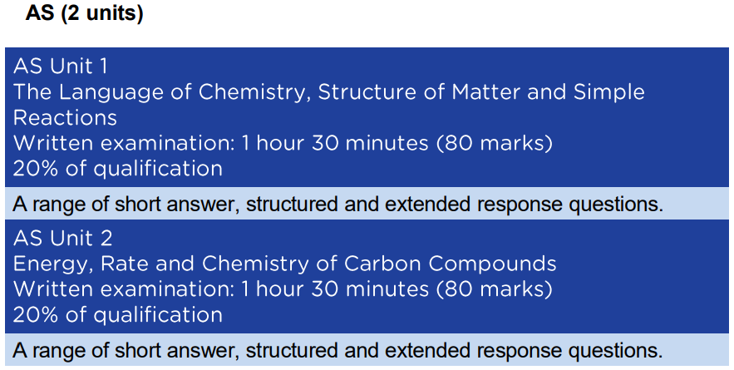
Course content and delivery
Give a brief outline of the course content and the method of delivery over the 1 – 2 years.

Slide 8
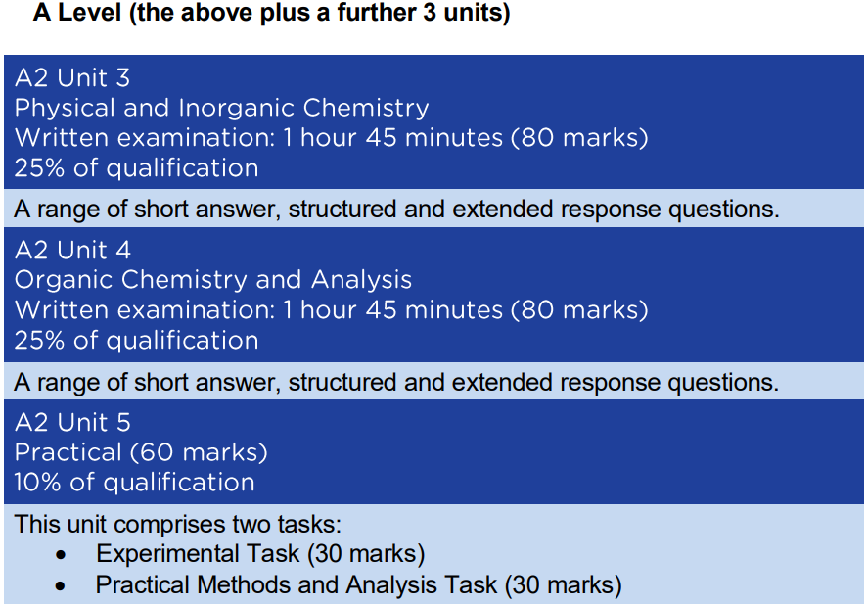

Slide 9
How can these skills be applied to different subjects/areas of life?
The study of Chemistry encourages a deep appreciation of how the human race can change and manipulate the world around us to meet our specific needs.
Over the years, Chemists have played key roles in the development of modern technology, ranging from the creation of new materials to the development of new manufacturing techniques. Without competent Chemists, technology does not progress!
Chemistry is a unique subject in that it requires a high level of competency is a variety of different skills. Literacy, numeracy and logical reasoning are integral parts of a Chemist’s skill set. A good imagination helps too!
Practical work is an essential part of Chemistry. Studying Chemistry will help you develop fine motor control and coordination as you perform highly precise experiments such as titration, calorimetry and synthesis.

Slide 10

Physics

Slide 11
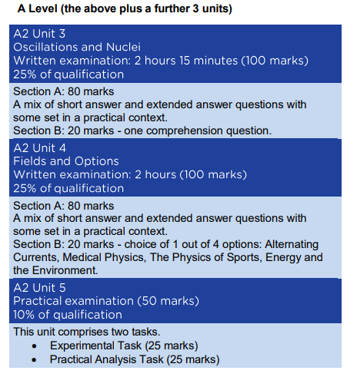
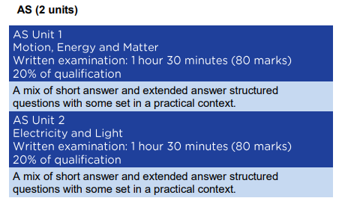
Course content and delivery
Give a brief outline of the course content and the method of delivery over the 1 – 2 years

Slide 12
How can these skills be applied to different subjects/areas of life?
Studying this A level in Physics encourages learners to:
develop essential knowledge and understanding of different areas of the subject and how they relate to each other
develop and demonstrate a deep appreciation of the skills, knowledge and understanding of scientific methods
develop competence and confidence in a variety of practical, mathematical and problem solving skills
develop their interest in and enthusiasm for the subject, including developing an interest in further study and careers associated with the subject
understand how society makes decisions about scientific issues and how the sciences contribute to the success of the economy and society.

Slide 13
Applies to Biology, Chemistry and Physics

Slide 14
Formal Assessments
How is the course assessed?
Year 12: written external exams for unit 1 and 2
Year 13: written external exams for unit 3 and 4 AND a practical exam for Unit 5.
When will the assessments take place?
In May / June of each year: written exams
Unit 5 (Practical exam) COVID Changes for Current Year 13
Biology: 10th and 13th May 2022
Chemistry: 17th and 20th May 2022
Physics: 3rd and 6th May 2022

Slide 15
Formal Assessments
What preparation needs to be done beforehand?
Throughout the course there are end of topic tests which should be considered important milestones.
Complete all homework which is set on Google classroom.
Will pupils have resit opportunities to improve their results?
Yes re-sitting is an option for Year 12 exams, but it is not encouraged in the department, as we find it adds to stress in the final year of study.

Slide 16
Skills Development
What skills will pupils develop through studying the course and how will they do this?
Develop scientific thinking
Experimental skills and strategies
Analysis and evaluation
Scientific vocabulary, units, symbols, quantities and nomenclature
Numerous mathematical skills
What can they do to practise these skills?
Complete all homework set by the class teacher.
Use WJEC question bank for more examples of questions.
Make use of online resources, such as https://resources.wjec.co.uk/ , https://www.physicsandmathstutor.com/ (which has biology, chem and physics).

Slide 17
Our Expectations
What are your expectations in terms of
presentation of work?
All work should be neat and up to date – it is the responsibility of the student to keep up to dates with notes and expectations for lessons.
homework?
Homework is set on Google classroom, with deadlines to help get organised.
preparation for assessments?
Complete all the classwork and homework set. For extra preparation use WJEC question bank to find more questions to try out.
Equipment needed for lessons/exams?
For every lesson presume you need a pen, pencil, ruler, rubber and a calculator. We do use the text book in Biology and Physics

Slide 18
Resources and Support
What resources will you make available to support learning?
Google classroom will hold all the resources.
Some materials are handed out in class.
What support both within and outside lessons will be provided to support pupils?
Revision sessions when needed
Access to teaching staff during non-contact lessons
Email / google classroom for point of contact

Slide 19
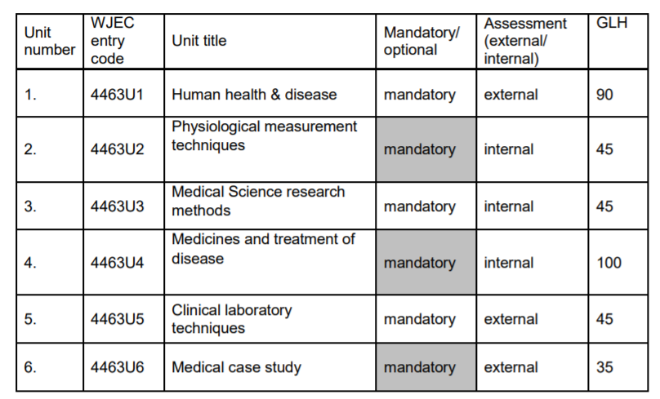

Medical science
Unit 1 – 3 are in Year 12
Unit 4 – 6 are in Year 13

Slide 20
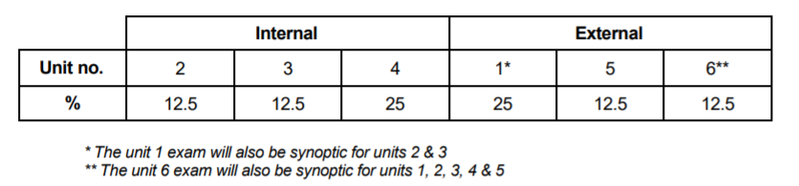
Weighting of different units

Slide 21
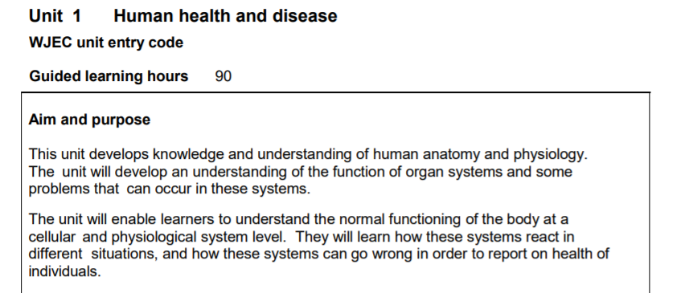
Unit 1 is very similar to the start of AS biology course, concentrating on human anatomy.
Assessment is an external written paper sat in the summer of Year 12, made up of two parts: Recall questions and response to stimulus material.

Slide 22
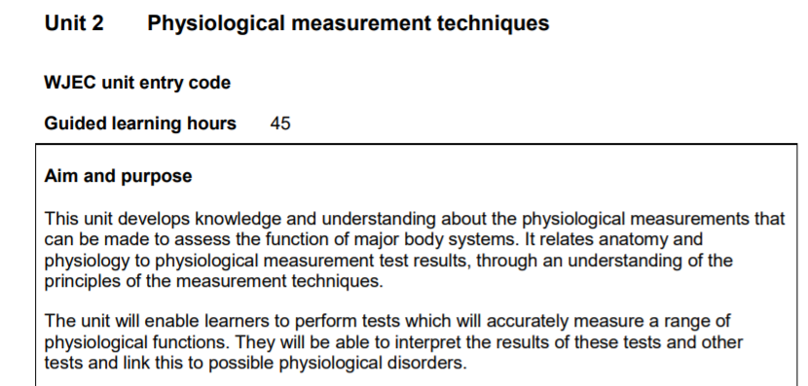
Unit 2 centres around understanding our physiological systems and how we can perform tests to check the functioning of these systems.
Assessment is in the form of internally assessed case study, external verified. Students will write about how to perform certain physiological tests and then collect and analyse data – to link to diseases.

Slide 23
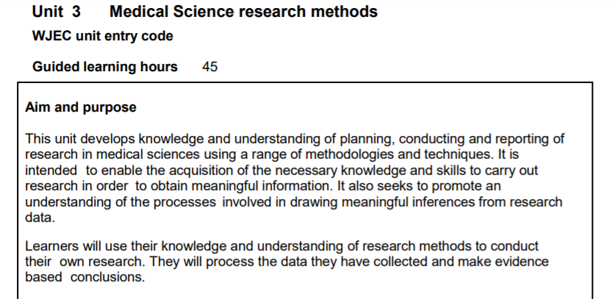
This unit is really useful in terms of developing student confidence in research skills, transferrable to many disciplines.
Assessment is in the form of internally assessed case study, external verified. It takes the form of designing, carrying out and analysing a case study in the form of a research project. Quite heavy on mathematical content here.

Slide 24
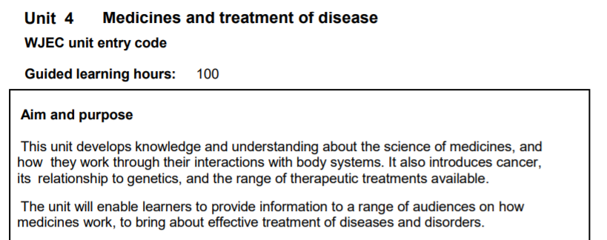
This unit looks into the use and effectiveness of medicines to treat diseases.
Assessment is in the form of internally assessed case study, external verified. It takes the form of a series of individual and group work, to produce leaflets and perform 2 group presentations.

Slide 25
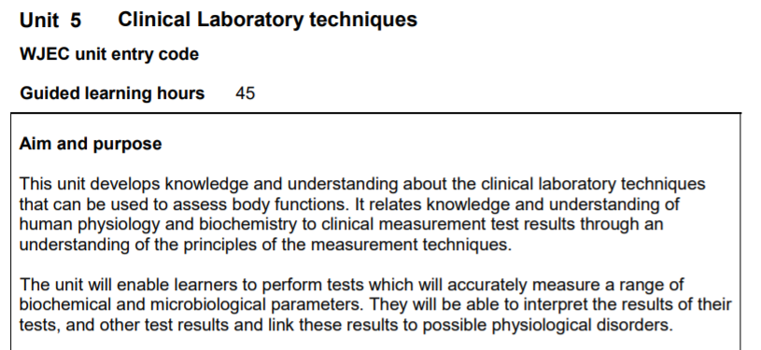
This unit is based around the pathology department in a hospital, looking at the diagnostic tests carried out. Students also have the opportunity to perform some of these simple tests in the lab with us.
Assessment is externally marked by WJEC and comprises of students carrying out practical tasks to determine a medical understanding of a given situation.

Slide 26
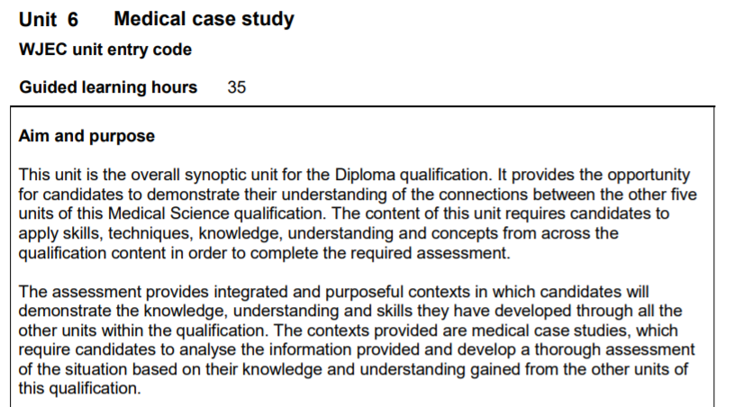
This unit has no new content, but looks to bring together all the skills and knowledge developed over the 2 year course.
This unit is assessed through a written examination set each summer. It is a synoptic assessment of the entire qualification.

Slide 27
Medical science is VERY different to A Level Sciences!
Not all units are assessed by external written exams.
Significant amount of self study required to research and find out information.
Meeting deadlines set by teachers is critical to submit to WJEC for verification.
A laptop is essential to work in class each lesson, all work is online.

Slide 28
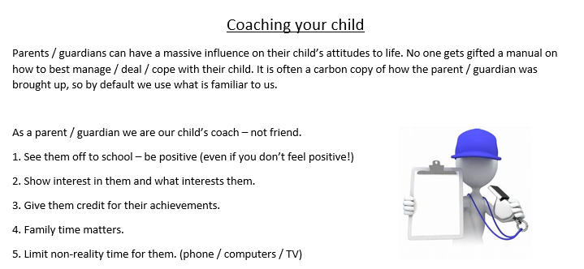
How can parents/carers support their children in your subject?

Slide 29
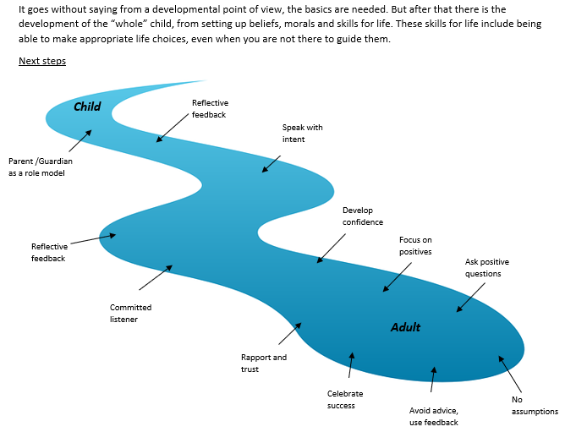
fbrodrick@Maesydderwen-hs.powys.sch.uk

