Slide 1
Working Together,
Achieving More
Cydweithio a Chyflawni
Year 12/13
Information Evening
November 2021
AS/A Level Religious Studies
UG/Safon Uwch
Astudiaethau Crefyddol

Slide 2
Course content and delivery
Give a brief outline of the course content and the method of delivery over the 1 – 2 years
The course is delivered over 2 years. Pupils study:
Year 1 (AS Level) = 40% | Year 2 (A Level) = 60%
1. An Introduction to the Study of Religion – Buddhism. | 3. Study of Religion - Buddhism
2. An Introduction to the Religion and Ethics and Philosophy of Religion. | 4. Religion and Ethics.
 | 6. Philosophy of Religion.

Slide 3
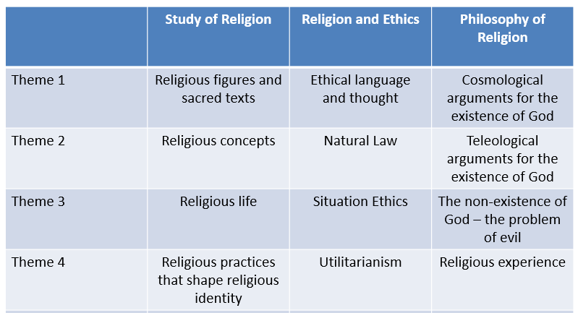
Course content and delivery
Course content Year 1 – AS Level

Slide 4
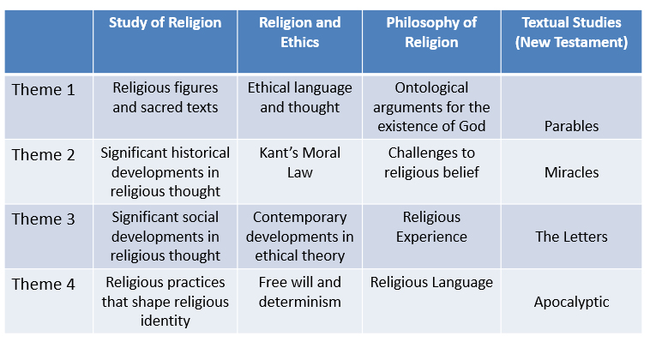
Course content and delivery
Course content Year 2 – A Level

Slide 5
Assessment
How is the course assessed?
Each theme is weighted as a percentage of the total mark.
Each AS Level Unit has a different weighting: Unit 1 = 15% & Unit 2 = 25%
Each A Level Unit has an equal weighting of 20%.
When will the assessments take place?
AS Level papers are sat at the end of Year 12 and A Level papers are sat at the end of Year 13. Pupils will have the opportunity to resit the AS papers at the end of Year 13.
What preparation needs to be done beforehand?
Pupils will need to practice past paper questions and thoroughly revise key topics in preparation for both exams. There is no coursework element.

Slide 6
Skills Development
What skills will pupils develop through studying the course and how will they do this?
The course is designed to help pupils to:
understand, interpret and evaluate critically religious concepts, texts and other sources
construct well informed and reasoned arguments about religion and belief, substantiated by relevant evidence
account for the influence of social, religious and historical factors on developments in the study of religions and beliefs
identify, investigate and critically analyse questions, arguments, ideas and issues arising from the study of religion including those of scholars/academics.
What can they do to practise these skills?
To practice these skills pupils can engage in debate and discussion in response to world events with friends and family and apply the range of religious, philosophical and ethical views and theories they are studying.
At times, there are also useful documentaries, films or series that help to support or stretch understanding.

Slide 7
Our Expectations
What is expected of pupils?
There are high expectations of pupils to:
develop their interest in a rigorous study of religion and belief and relate it to the wider world
develop knowledge and understanding appropriate to a specialist study of religion
develop an understanding and appreciation of religious thought and its contribution to individuals, communities and societies
adopt an enquiring, critical and reflective approach to the study of religion
reflect on and develop their own values, opinions and attitudes in the light of their study.
To produce their best work, pupils should:
keep up to date with deadlines for classwork and homework
revise for assessments & practice past paper questions
keep up to date with news about beliefs and ethics in the wider world.

Slide 8
Resources and Support
What resources will you make available to support learning?
For each section of the paper 1 & 2, students are provided with:
revision booklets
online access to textbook support
teacher prepared handouts
If available, study trips and access to expert speakers.
The following WJEC authorised textbooks are available to purchase online at:
https://www.illuminatepublishing.com/product-category/religious-studies
What support both within and outside lessons will be provided to support pupils?
Particular help will be provided in the use of past paper questions and regular ‘mock’ assessments. Parents/carers support their children development through discussion of current topics related to the exam and helping with revision.

