Slide 1
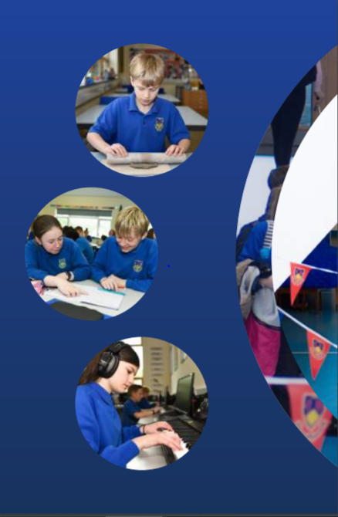
Working Together,
Achieving More
Cydweithio a Chyflawni
KS5
Information Evening
November 2021
Mathematics

Slide 2
Course content and delivery
AS and A level Mathematics provides a broad, coherent, satisfying and worthwhile course of study. It encourages pupils to develop confidence in, and a positive attitude towards mathematics and to recognise its importance in their own lives and to society.
Pupils will study both a Pure and Applied Mathematics unit each year. Pure mathematics builds on the work done at GCSE level whilst extending the range of mathematical skills and techniques to solve more difficult problems. The Applied units will comprise of both Mechanics and Statistics topics.
Pupils will have four hours of taught lessons per week and in addition will be expected to spend time on independent study and revision.

Slide 3
Assessment
How is the course assessed?
Both AS and A2 Mathematics are assessed by external written examinations.
There are two paper for AS and two for A2
The papers will comprise a number of short and longer, both structured and unstructured questions, which may be set on any part of the subject content of the unit.
Calculator will be allowed for all examinations.
When will the assessments take place?
AS examinations will take place in the Summer term of Year 12.
A2 examinations will take place in the Summer term of Year 13.
What preparation needs to be done beforehand?
Throughout the course pupils will be working on exam standard questions and complete end of unit tests to monitor progress. Homework tasks are set each week to monitor understanding and engagement.

Slide 4
Skills Development
What skills will pupils develop through studying the course and how will they do this?
Whist studying Maths at A-Level, you will develop a number of skills, such as problem-solving, analytical skills, research skills and logic. Maths allows you to hone your ability to solve mathematical problems as well as abstract and scientific ones. You’ll also learn how to analyse patterns, structures and problems, which will in turn, help you to develop a critical eye.
What can they do to practise these skills?
Pupils will need to ensure they have a sound understanding of the basic concepts as they are studied and will be given targeted exercises to embed this knowledge. Pupils will also need to regularly practice their problem solving skills by working on exam standard and enrichment questions.
How can these skills be applied to different subjects/areas of life?
Maths is a subject where you’ll gain many transferable skills that can be applied to many different areas. A level maths will support study in many other subjects such as science and engineering and the logical abilities you will develop means you will have the tools needed to tackle a number of diverse areas of your life, from managing your finances to planning projects

Slide 5
Our Expectations
Presentation of work:
All work needs to be completed on time to an appropriate standard with clear workings out shown.
Homework:
Regular homework is set for all pupils, usually weekly.
Preparation for assessments:
Revision tasks/ review exercises will be set for each assessment. It is important that these are well prepared for so that sufficient time can be spent on target topics that need further practice.
Equipment needed for lessons/exams:
For each lesson pupils would be expected to have basic stationery and a scientific calculator.
A calculator with statistical tables will be required for the Statistics element of the course.

Slide 6
Resources and Support
Resources available to support learning:
Support for pupils:
The work for every Maths lesson is available electronically via the lesson planner in Google classroom.
Pupils will have access to all exercises, past papers and model solutions in the Google classroom.
All pupils will be provided with extensive revision materials, including past papers and given links to appropriate online revision tutorials.
How can parents/carers support their children?
Help your child be organised - the key to effective revision.
Make sure all homework tasks are up to date.
Make sure they have a quiet and uncluttered study space at home.
Use revision guides and summary notes to test their knowledge of facts and encourage pupils to write their own.
Encourage them to work for shorter periods, more frequently.

Slide 7
Resources and Support
Links to Online Resources
Most resources will be uploaded to the Google classroom
Mathswatch
WJEC website
Dragon maths

