Slide 1
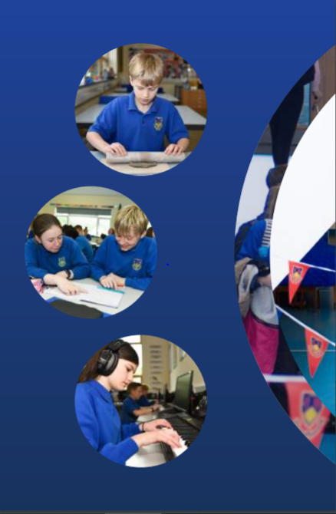
Working Together,
Achieving More
Cydweithio a Chyflawni
Year 10 and 11 Information Evening
21st October 2021
Physical Education

Slide 2
Course content and delivery
The GCSE Physical Education course runs over one year. Pupils can take the course in year 10 or year 11.
The course is divided into two parts the written exam and practical performance.
Through studying GCSE Physical Education learners will acquire the knowledge, understanding, skills and values to develop and maintain their performance in physical activities and understand the benefits to health, fitness and well-being. Learners will develop theoretical knowledge and understanding of the factors that underpin physical activity and sport and use this knowledge to improve performance.
Learners will perform effectively in different physical activities by developing skills and techniques and selecting and using tactics, strategies and/or compositional ideas. They will develop their ability to analyse and evaluate to improve performance in physical activity and sport.

Slide 3
Assessment
Physical Education (Full Course)
Introduction to theory in Physical Education (Written exam) 50%.
Learners will be assessed through a range of short and extended questions. The questions will be based on audio-visual stimuli and other sources.
The written examination: 2 hours
Participation in physical education 50%.
Learners will be assessed in two different activities in the role of performer.
Candidates can be assessed at intervals throughout the course. The final marks submitted should be a true reflection of the candidates' level of performance.
Practical moderation will require video evidence.
Pupils performance must be internally assessed by the teacher.
Practical moderation is usually completed by end of March and written theory exam in June.

Slide 4
Skills Development
Theory content focuses on five key unit areas:
1. Health, training and exercise
2. Exercise physiology
3. Movement analysis
4. Psychology of sport and physical activity
5. Socio-cultural issues in sport and physical activity.
Each key area will be internally assessed. To support final grade and assessment process.
In practical performance.
For the team sports/activities candidates should: demonstrate the application of skills/techniques/strategies appropriate to the position/activity in demanding situations i.e. in small sided and full sided games in competitive contexts.
For individual sports/activities candidates should: demonstrate the application of skills/techniques/strategies appropriate to the activity in demanding pressure situations.

Slide 5
Our Expectations
The PE departments expectations is that pupils are participating in sport outside of school, demonstrating commitment to sport with a willingness to learn and develop their fitness.
Homework is set at times within the department. However, participation in sport outside of school is seen as the constant homework that the pupils need to participate in.
Pupils will be expected to bring appropriate kit for every lesson.
Complete all work set and use google classroom when necessary.
Pupils should thoroughly revise before unit tests to achieve the best grade possible.

Slide 6
Resources and Support
At the end March the PE department will be giving out revision pack. The pack will have revision guide for each theory unit and past papers to complete.
The WJEC website has the whole course outlined in the specifications. In its digital resource it gives all the theory context broken down with questions. You can also access past papers and answers.
https://www.wjec.co.uk/qualifications/physical-education-gcse/#tab_overview
https://www.bbc.co.uk/bitesize/subjects/znyb4wx
A lunchtime club will be made available to pupils to catch up with work or pupils who need help. This will start running after October half term.
Parents can support the pupils in Physical Education by helping pupils with their commitment to sport outside of school and remind pupils of their timetable for appropriate PE kit for lessons.

