Slide 1
Working Together,
Achieving More
Cydweithio a Chyflawni
Year 10 and 11 Information Evening
21st October 2021
Design and Technology
Product Design

Slide 2
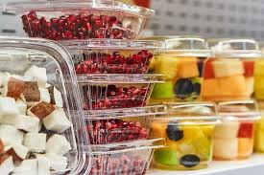
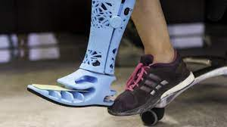
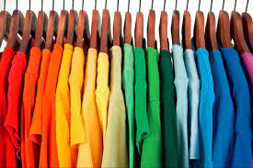
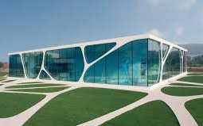
What is Product Design?
From the phone that we use multiple times a day, the clothes that we wear, the buildings that we occupy, medical equipment and the packaging of products in our shop. Product design is truly all around us.
Product design is something that impacts every one of us multiple times a day, whether we are aware of it or not. It is about the well designed solutions that solve problems that we face. Designing includes sketching, computer aided design and prototype models. Testing is key to product design, testing all the way through to test the product.
This course is for those who have a passion for making and want to develop their creative skills and solve problems through product design. You must be prepared to work hard and demonstrate creative thinking. This course will provide opportunities for students to take creative risks, build confidence and express themselves.
Notes:
Hello, and welcome to product design. My name is Mrs wright and I am one of the product design teachers at ysgol maesydderwen.

Slide 3
Course content and delivery
GCSE Design and Technology
Product Design
The product design course is creative and thought provoking. It involves practical skills, theoretical skills, knowledge of materials, processes and you will gain a real understanding of being a designer.
You will have the freedom to be creative, working in 2D and 3D form using different techniques. You will have an understanding about sustainability and how the design process works along with learning how to use hand tools and machines in the workshop.
Lessons will consist of controlled assessment, practical workshops and theory lessons. You will be encouraged to experiment with a variety of materials in order to test your design ideas. You will end up with a design portfolio and the opportunity to study Product Design at A-level.

Slide 4
Assessment
How will the course be assessed?
50% Controlled assessment (Coursework project)
Based on 3 briefs selected by the exam board, you will be required to choose one to investigate using product analysis, customer research, prototyping and testing materials to solve a problem that you have identified.
50% Written exam
Based on the theory which including designers, smart and modern materials, manufacturing processes and the design process.
When will the assessments take place?
Controlled assessment with take place from June until May (the last year of the course).
The exam will be at the end of the course in June.
What preparation needs to be done beforehand?
You will be required to revise for the exam using the theory work done in class.
Will pupils have resit opportunities to improve their results?
Yes, you will be able to resit your exam.

Slide 5
Skills Development
What skills will pupils develop through studying the course and how will they do this?
Problem solving and creativity skills through planning and evaluating a product.
Sketch development features heavily in the subject, this is to help visualise the solution to the problem you are solving.
You will have an understanding of a variety of materials and design processes.
CAD/CAM skills through using the laser cutter as well as traditional hand tool processes.
How can these skills be applied to different subjects/areas of life?
Architect
Engineer
Carpenter
Industrial design
Interior design
Landscape design
Product design
Games design
Teacher
The amount of jobs are endless for product design. If a product is being designed, then there is more than likely a job that goes with it.

Slide 6
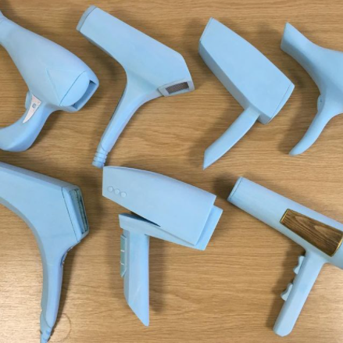
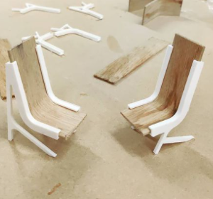
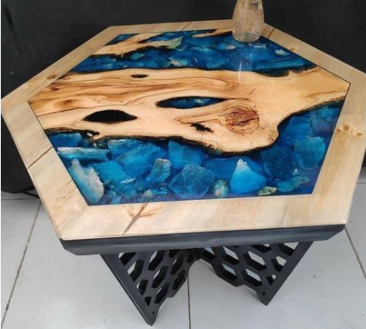
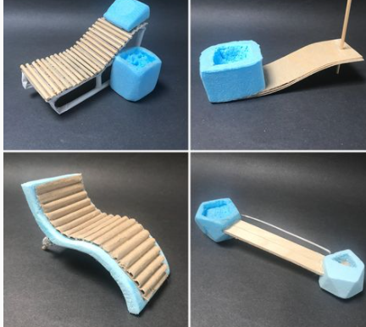
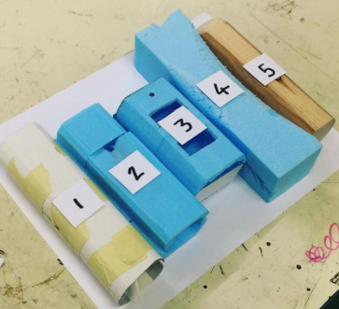
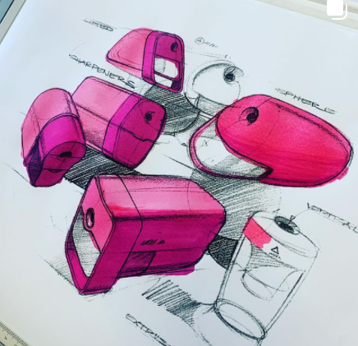
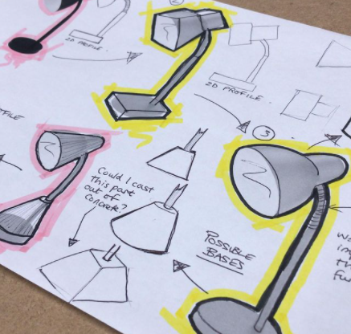
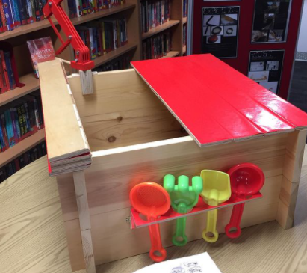
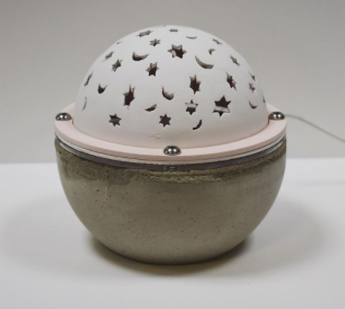
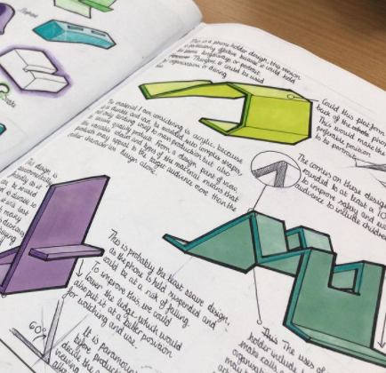
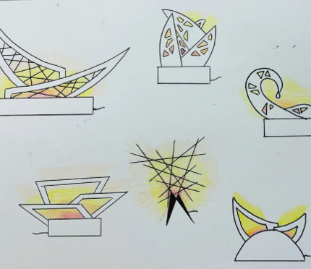
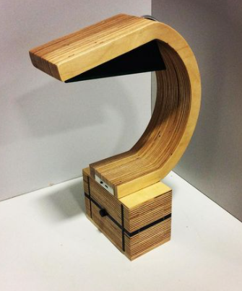
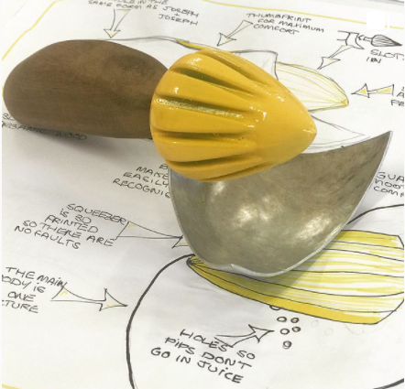
Examples of work
Final product
Design development
Prototypes
Notes:
Here are some examples of work, the design development starts with drawing and communication ideas. Then moving on to prototypes where several models are made to test the function, size and materials. Final products can be made using a variety of materials including wood, plastic, cement and resin.

Slide 7
Our Expectations
How will you be expected to present your work?
Work will be presented in an A3 portfolio and a sketch book. You will present your work on paper, either using the computer or written by hand. You will be expected to use creativity and communicate your ideas clearly through annotation, drawing and computer aided design.
What will be set as homework?
Homework tasks will be set based on the theory in lessons to further your knowledge and understanding of topics previously mentioned.
What equipment will be needed for lessons?
General classroom equipment such as pen, pencil, ruler, rubber and sharpener will be expected. You will be given an A3 portfolio to display your work. There might be a cost for materials for the final product if materials cant be resourced at school depending on what the product is.

Slide 8
Resources and Support
What resources will you make available to support learning?
All resources taught in the lesson will be available to pupils and uploaded to Google Classroom. Pupils will have access to GCSE POD and online resources.
What support both within and outside lessons will be provided to support pupils?
Teachers will provide after school catch up sessions for pupils to attend. Pupils have been informed which days are available. Mrs Wright’s class have been offered a Wednesday after school as they are currently working on their controlled assessment.
How can parents/carers support their children in your subject?
Ensure pupils are signed up to GCSE POD, ensure pupils are checking Google Classroom and meeting deadlines. Check homework deadlines.
If you have any questions please speak to Mrs Mcgibney or Mrs Wright and we will be happy to help.
nmcgibney@maesydderwen-hs.Powys.sch.uk
jwright@maesydderwen-hs.Powys.sch.uk

