Slide 1
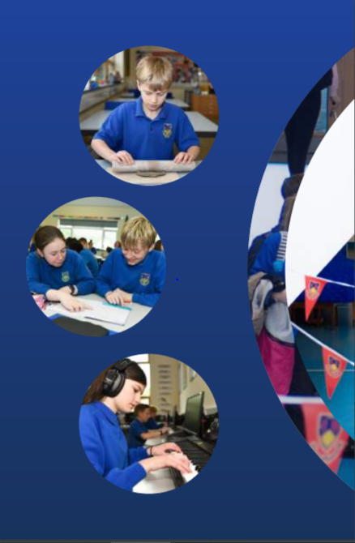
Working Together,
Achieving More
Cydweithio a Chyflawni
Year 10 and 11 Information Evening
21st October 2021
Skills Challenge Certificate

Slide 2
Course content and delivery
The Skills Challenge Certificate is a mandatory qualification at Key Stage 4 for all pupils in Wales.
It is a skills development qualification, equivalent to a GCSE. Pupils can achieve a similar range of grades for this qualification (A*, A, B, C, P*, P)
There are four components to the delivery of this:
Community Challenge**
Enterprise and Employability Challenge
Global Citizenship Challenge
Individual Project
** Due to Covid-19 adaptations, the current Yr 11 cohort will not be undertaking this challenge

Slide 3
Course content and delivery
There are four components to the delivery of this:
Community Challenge** (15%)
Enterprise and Employability Challenge (20%)
Global Citizenship Challenge (15%)
Individual Project (50%)
** Due to Covid-19 adaptations, the current Yr 11 cohort will not be undertaking this challenge

Slide 4
Assessment
How is the course assessed?
The course is assessed on classwork, undertaken regularly in lessons throughout the pupils’ progress through Yr10 and Yr11. Pupils will always be informed which tasks make up part of their assessed work before undertaking the task.
Work is then moderated internally to ensure consistency in completion and assessment, then entered to the WJEC exam board for external moderation.
Will pupils have resit opportunities to improve their results?
Unfortunately, pupils do not have the opportunity to re-enter work already completed and entered to the exam board. The are allowed, however, to start that work again and re-submit it if required.

Slide 5
Skills Development
What skills will pupils develop through studying the course and how will they do this?
As a skills based course, the whole purpose behind the qualification is to develop a wide range of pupil skills. These are specifically measured in different ways across the different challenges, but all are assessed in their final Individual Project.
Literacy, Numeracy, Digital Literacy, Problem Solving and Critical Thinking, Creativity and Innovation, Personal Effectiveness and Planning and Organisation
What can they do to practise these skills?
Apply the methods and strategies discussed in these lessons to their work across all subject areas in school. Skills in creating a CV and writing a cover letter for future job roles can also be used once pupils start to apply for jobs in the wider world.

Slide 6
Our Expectations
As work for Skills Challenge is continuous assessment throughout your lessons in Yr 10 and Yr 11, having a positive work ethic, good organisation of your work in your Google Documents area, handing in required tasks by the set deadlines in Google Classroom for teachers to give feedback if required, and responded positively to the feedback given are the key attributes of a successful learner in this qualification.

Slide 7
Resources and Support
What resources will you make available to support learning?
Pupils have access to wide range of support materials in each lesson, posted onto their Google Classroom area to help them complete the required tasks.
How can parents/carers support their children in your subject?
The best support that parents/carers can give for the Skills Challenge Certificate is the positive reinforcement of the importance in this qualification for pupils’ future educational pathways and career opportunities. As a mandatory subject, many pupils may not see its importance, but it has been the deciding qualification for many in terms of both college and future university applications being accepted. Promote its worth, and the importance of pupils adhering to set deadlines for assessment work.

